Slide 1
Web Development for Online Voting System
Team:
Md Shahnawaz
Ahad Wasim

Slide 2
Contents
Problem Statement
Introduction
Objective
Data Flow Diagram
ER Diagram
Language Used
Software Used
Snapshots
Significance of eVoting
Conclusion

Slide 3
Problem Statement
The major problem with current system is that it involves a lot of manual operations which are prone to errors and are definitely slow.
The whole election process is not environment friendly since the amount of paper required for single day is humongous.
Also, The whole process is so expensive because a lot of paper has to be bought, ballot boxes, and also the printing of the ballot papers.

Slide 4
Introduction
The purpose of this system is to implement the computerization of voter’s details, polling results, current polling and candidates.
The online polling system is supported through the college student records system. This allows students to login and be authenticated as an entitled voter for election purpose.
The online polling system is recognized as secure and accurate in its ability to authenticate students and to tabulate voting results.

Slide 5
Objective
To develop an online web-based voting system that can be used during the election period to vote for student leader.
To come up with system documentation.
To make a responsive and dynamic system which is connected to database and we the user can pull in information in variety of different ways depending on how we want to view them.

Slide 6
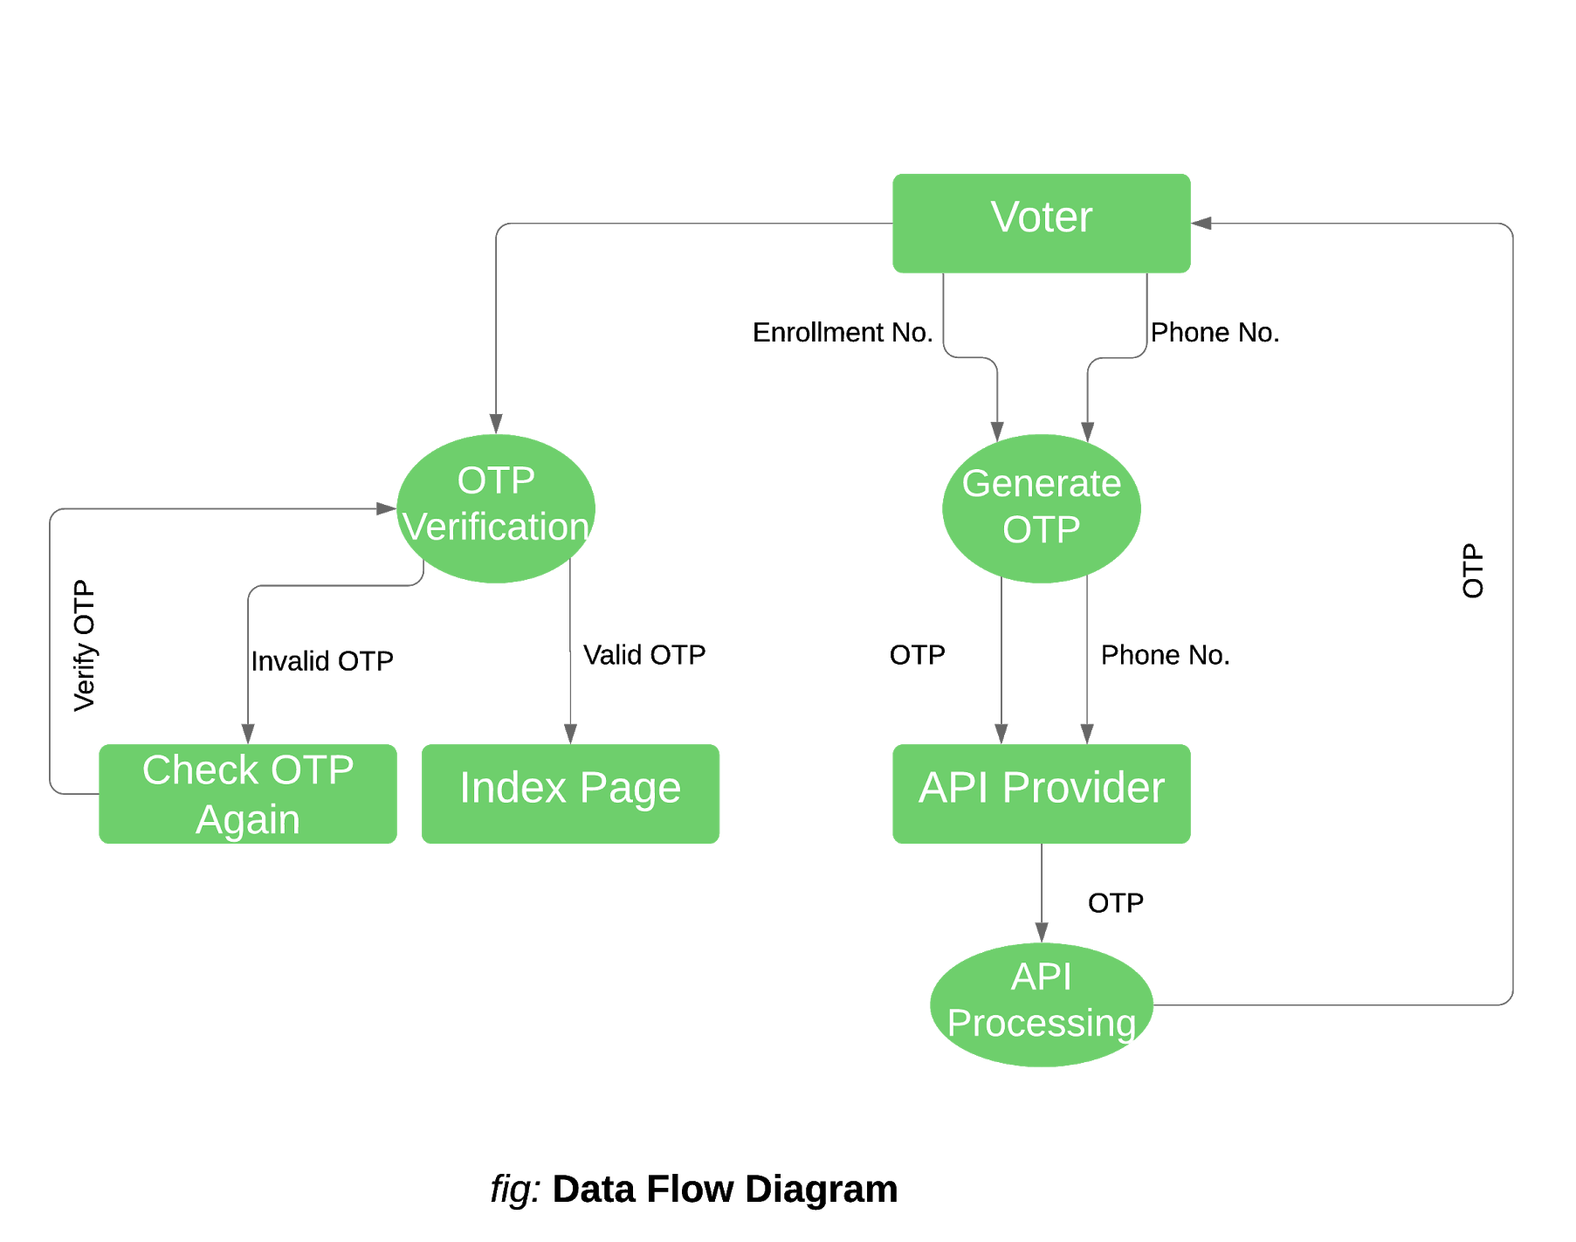
Data Flow Diagram

Slide 7
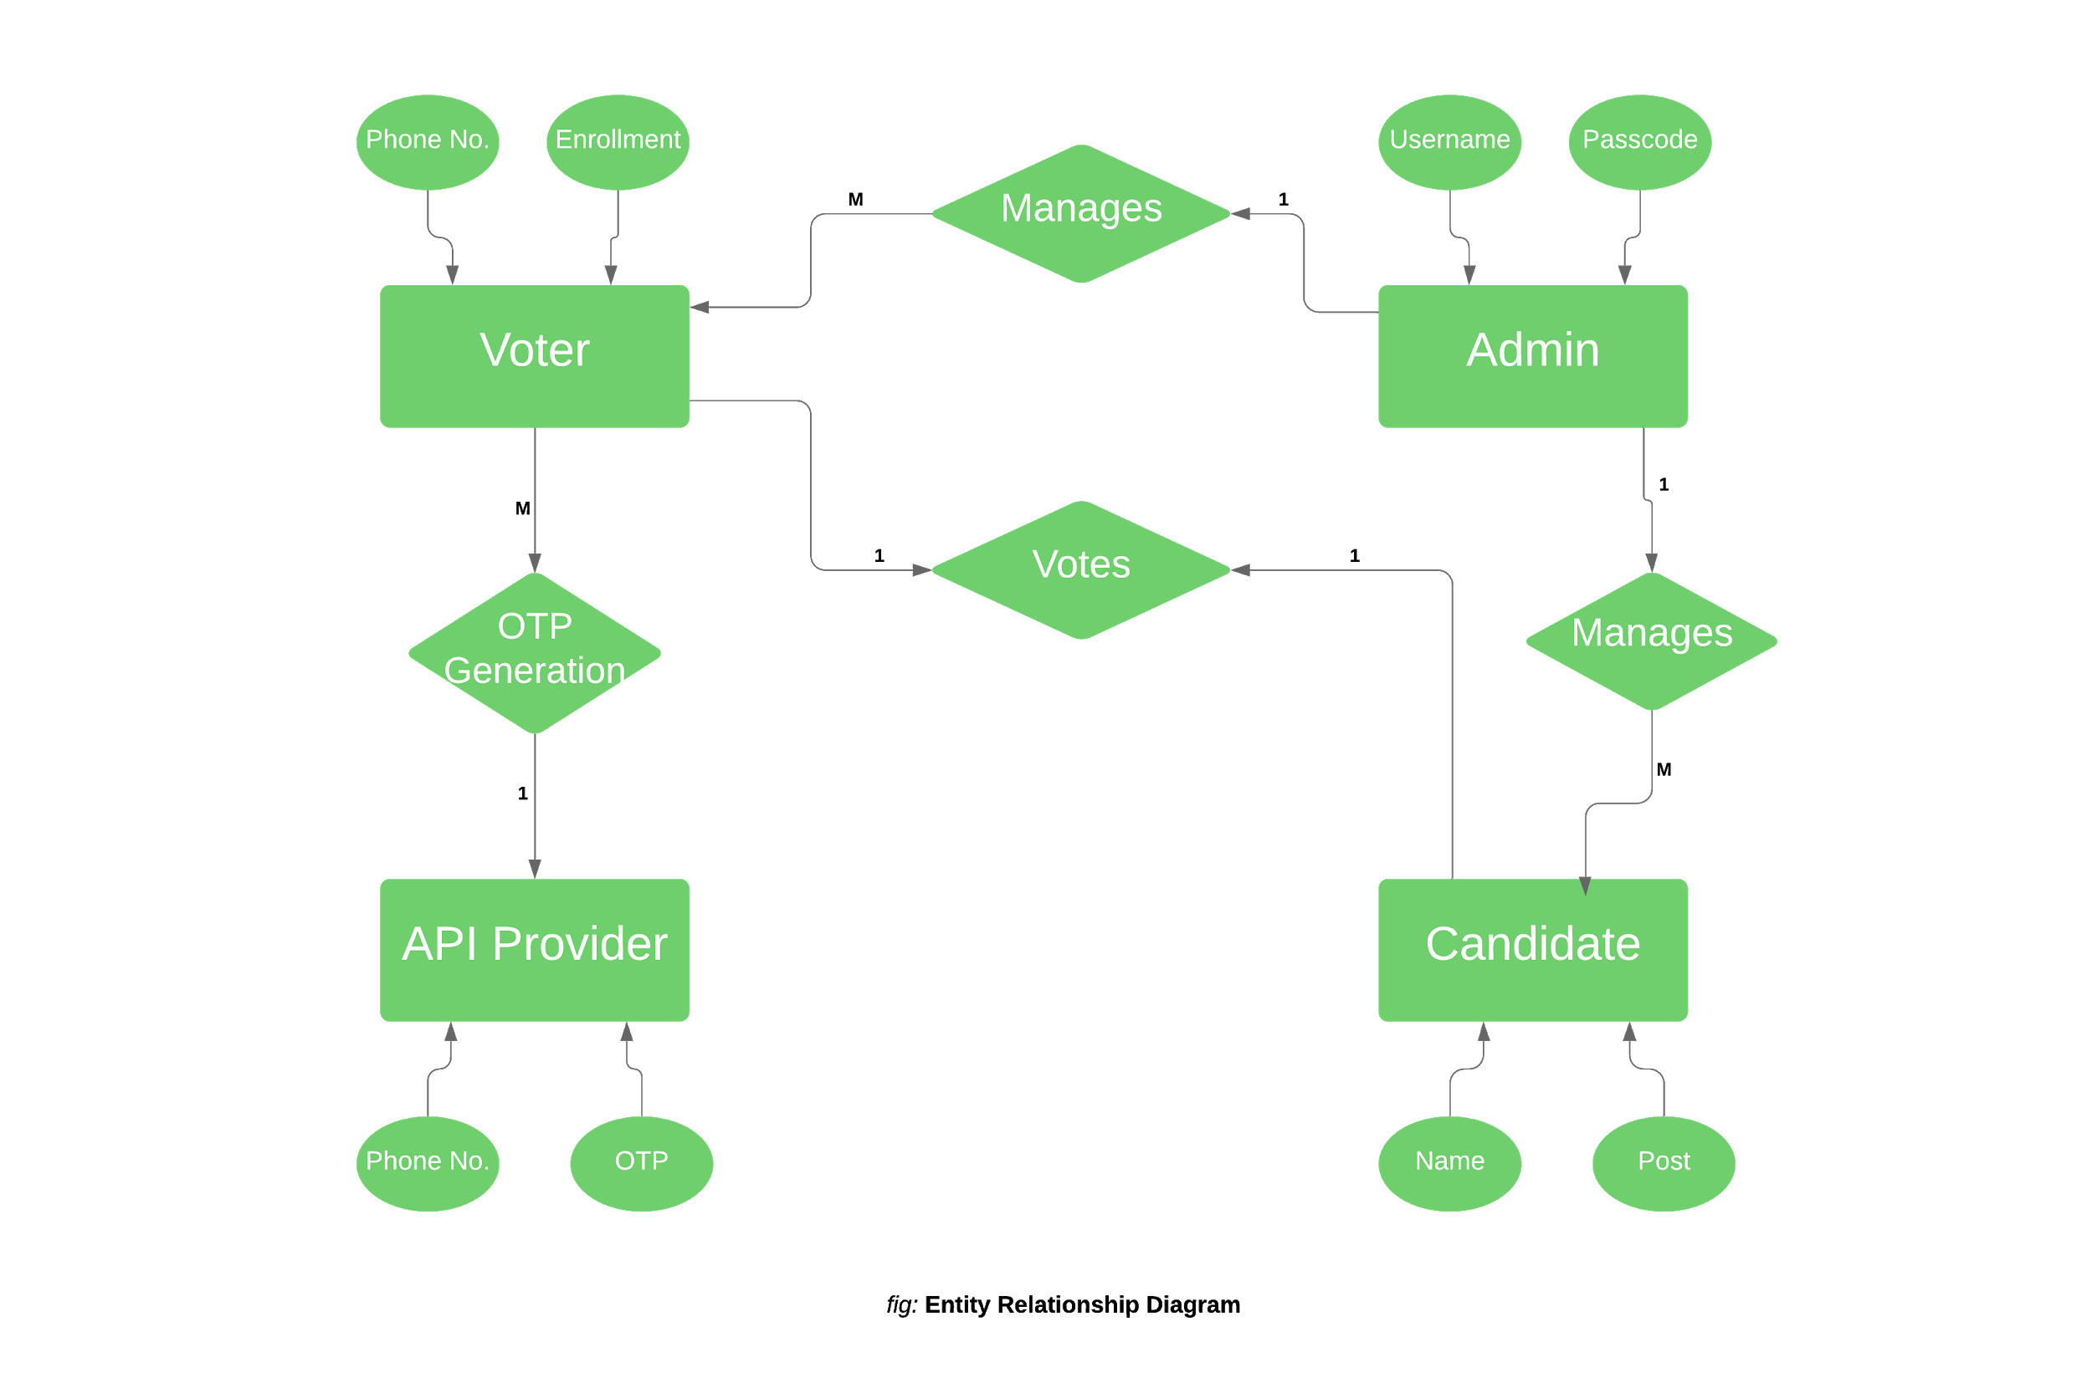
ER Diagram

Slide 8
Language Used
HTML5 – It is standard markup language for creating web-pages. It provides the basic structure of sites.
CSS3 – CSS makes the content of the web-pages presentable.
JavaScript – It is a client scripting language which is use to control the behaviour of different elements.
PHP – PHP can generate dynamic page content. PHP can add, delete, modify data in our database.

Slide 9
Softwares Used
Brackets: It is a cross-platform text editor. It comes with a variety of great, helpful features for bunch of languages.
XAMPP: It allows us to work on local server and test a local copies of websites using PHP codes and MySQL database.

Slide 10
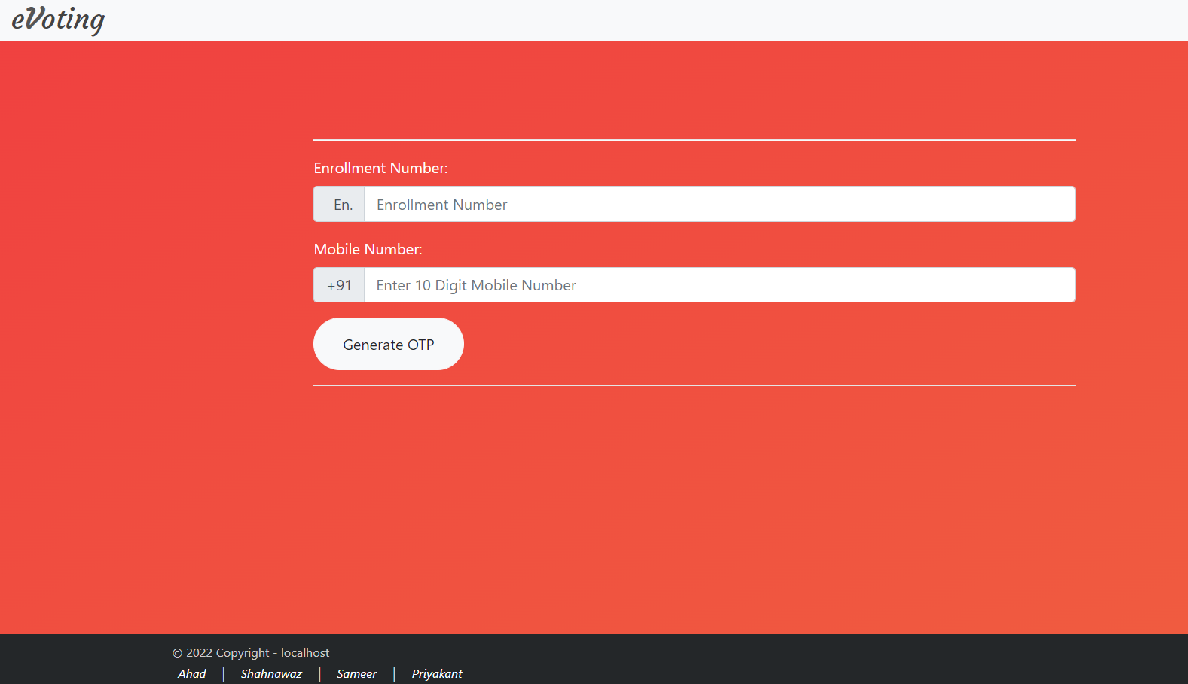
Snapshots
figure 1: Login Page

Slide 11
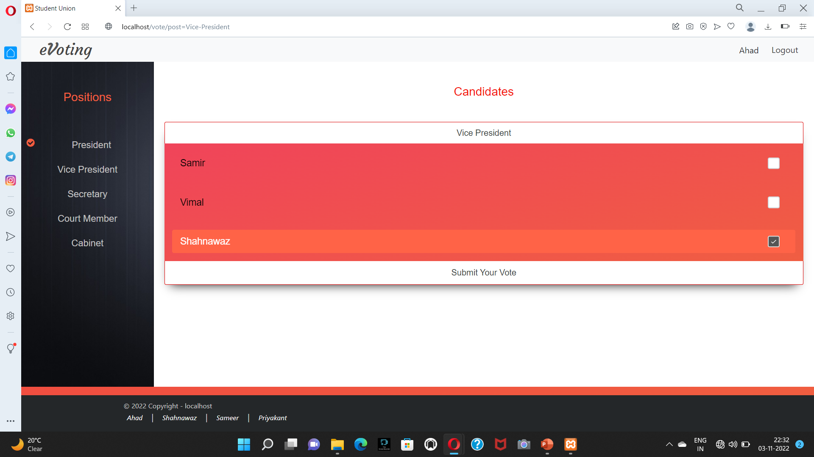
figure 2: Voting page

Slide 12
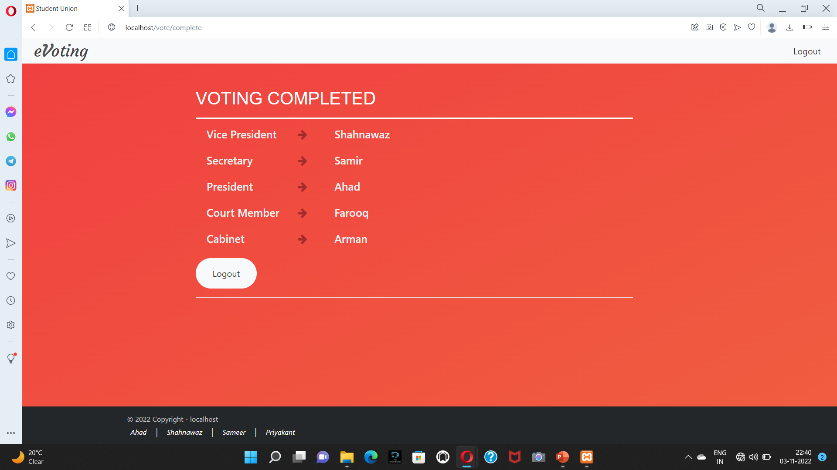
figure 3: Completion Page

Slide 13
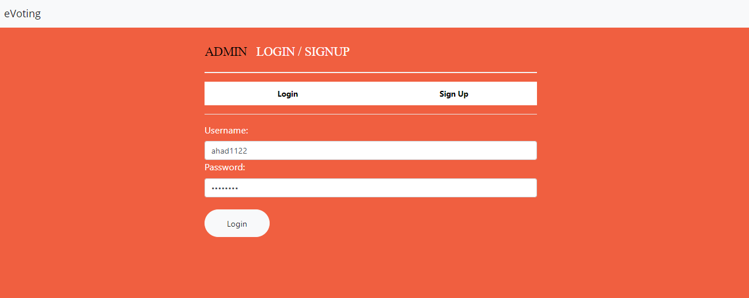
figure 4: Admin login page

Slide 14
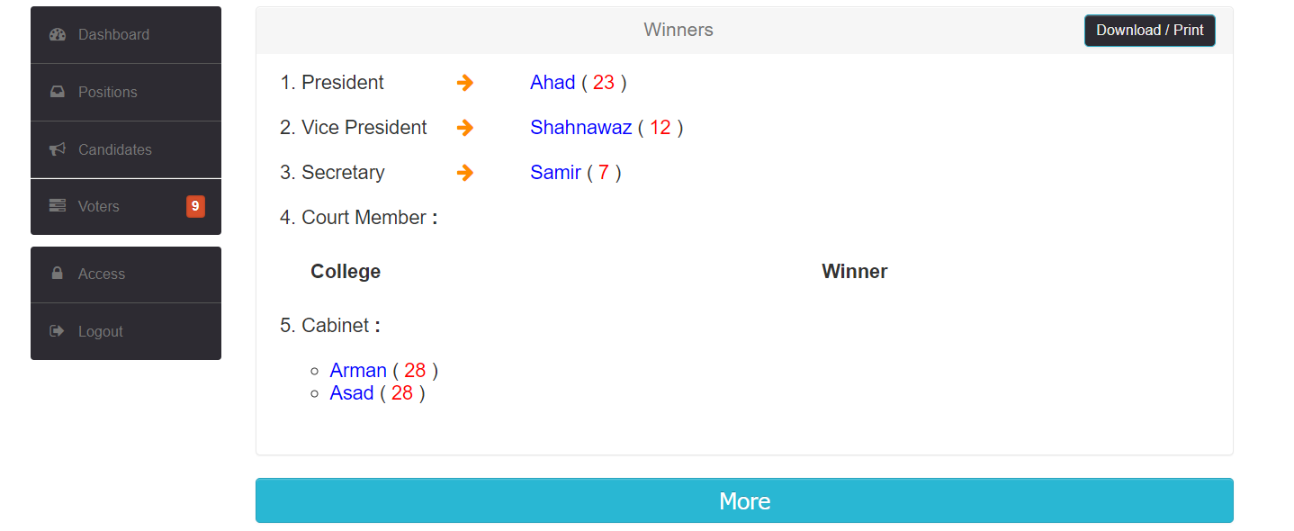
figure 5 : Scoreboard

Slide 15
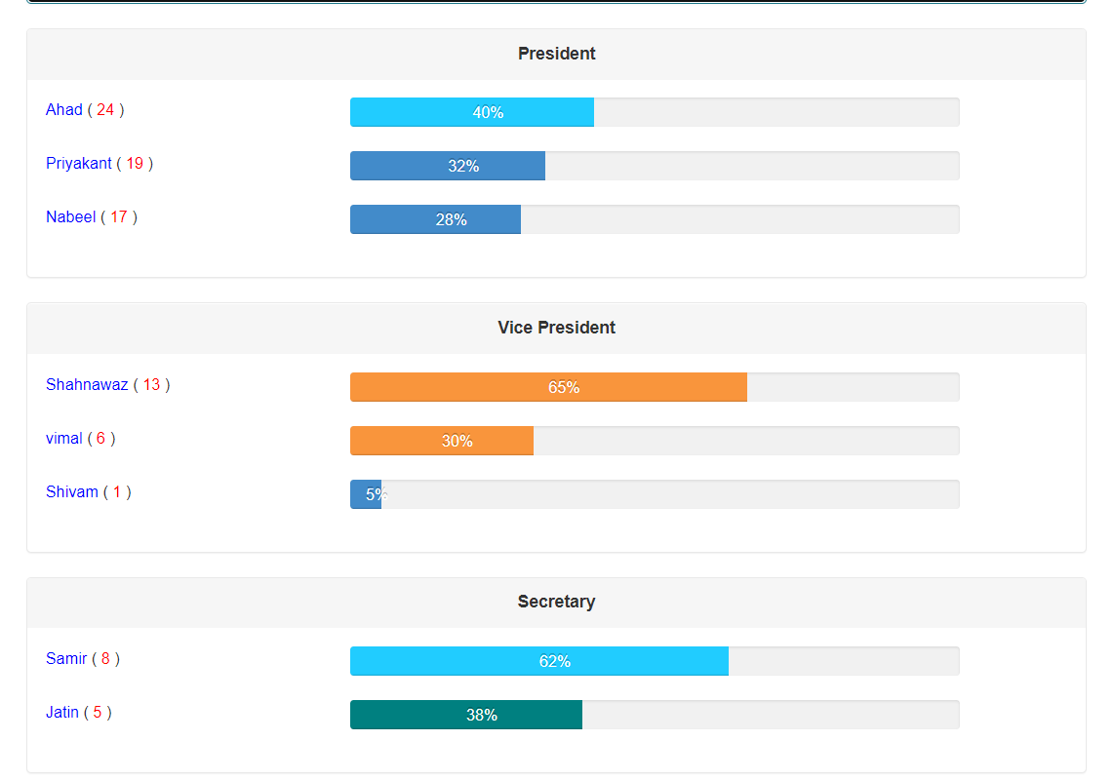
figure 6 : Live Update

Slide 16
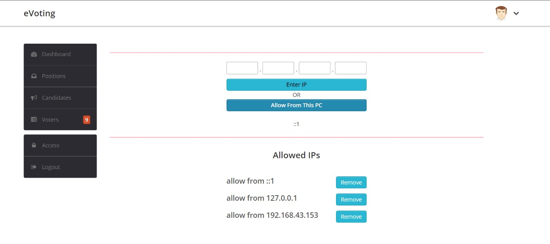
figure 7 : Protected Access

Slide 17
Significance of eVoting
The system is more secured with OTP implementation
Increase counting speed
Reduce human effort
No extra votes
Saves lot of time

Slide 18
Conclusion
This website can be used at any place to make election computerized such as University election, Lok Sabha, etc.
Our proposal enables a voter to cast his/her vote through internet without going to voting booth and additionally registering himself/herself for voting in advance.
Proxy vote or double voting is not possible, fast to access, highly secure, easy to maintain all information of voting, highly efficient and flexible. Hence, by this voting percentage will increase drastically.

Slide 19
THANK YOU

